Slide 1
Stream Clustering Efficient Kernel-based Approximation using Importance Sampling
Radha Chitta, Rong Jin and Anil K. Jain
Sebastian Appelt, LMU Munich

Slide 2
Outline
Real world example
Motivation
Key concepts
Deep dive with example
Discussion

Slide 3
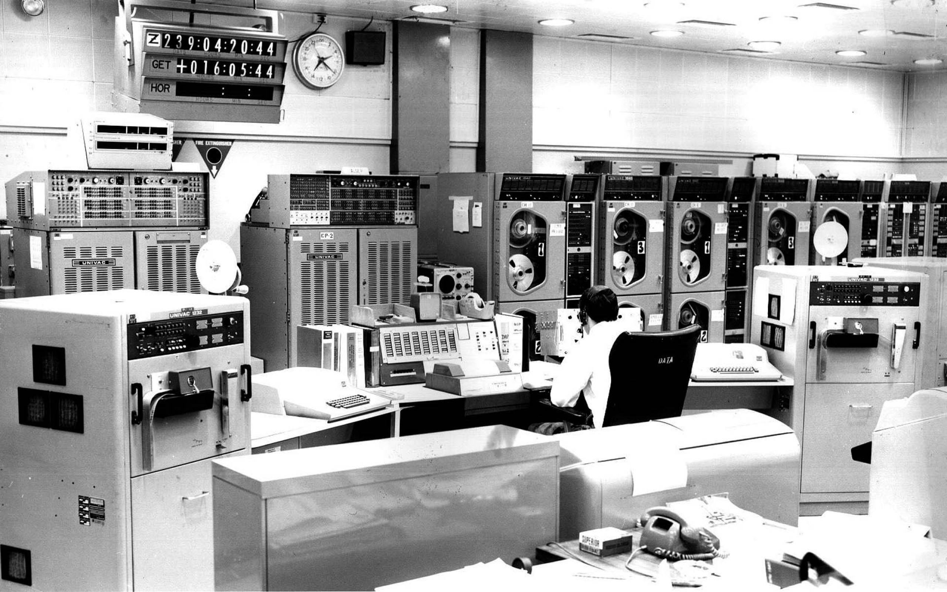
1 DDoS Attack Detection

Slide 4
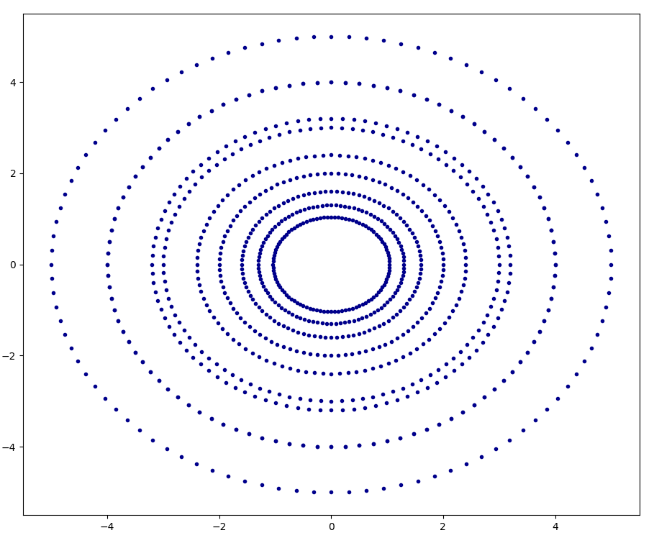
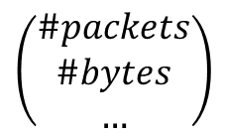
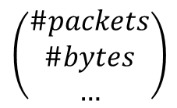
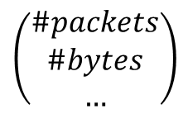
1 DDoS Attack Detection
Clustering traffic flow in networks
Flow X = (#packets, #bytes, #duration)
Build model of normal behaviour
$$\left(\begin{matrix}\#packets \\ \#bytes \\ …\end{matrix}\right)$$
$$\left(\begin{matrix}\#packets \\ \#bytes \\ …\end{matrix}\right)$$
$$\left(\begin{matrix}\#packets \\ \#bytes \\ …\end{matrix}\right)$$
Cluster
time
Traffic flow

Slide 5
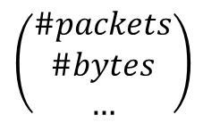
1 DDoS Attack Detection
Detect outliers that do not fit to a cluster
$$\left(\begin{matrix}\#packets \\ \#bytes \\ …\end{matrix}\right)$$

Slide 6
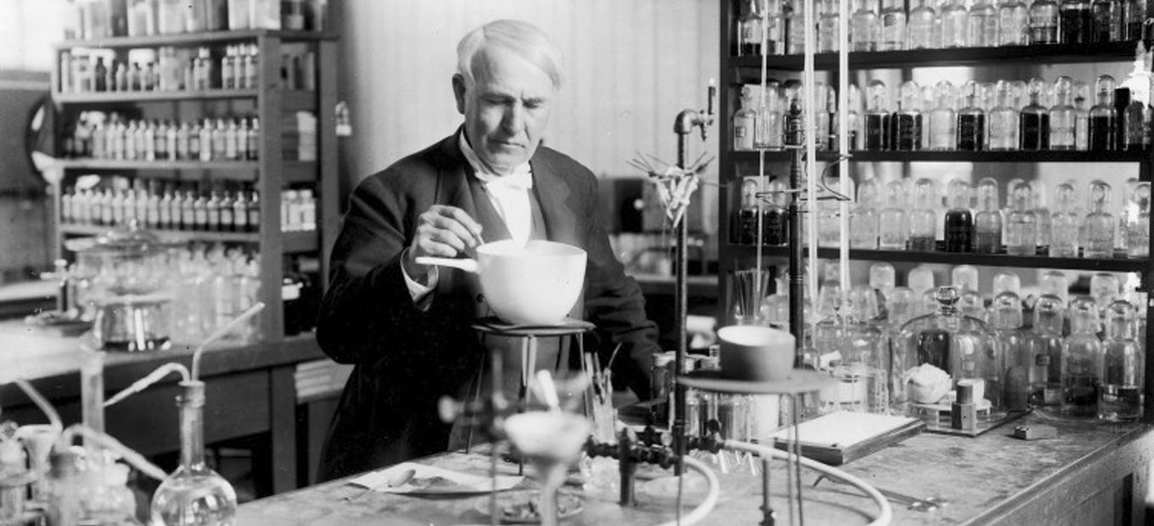
2 Motivation

Slide 7
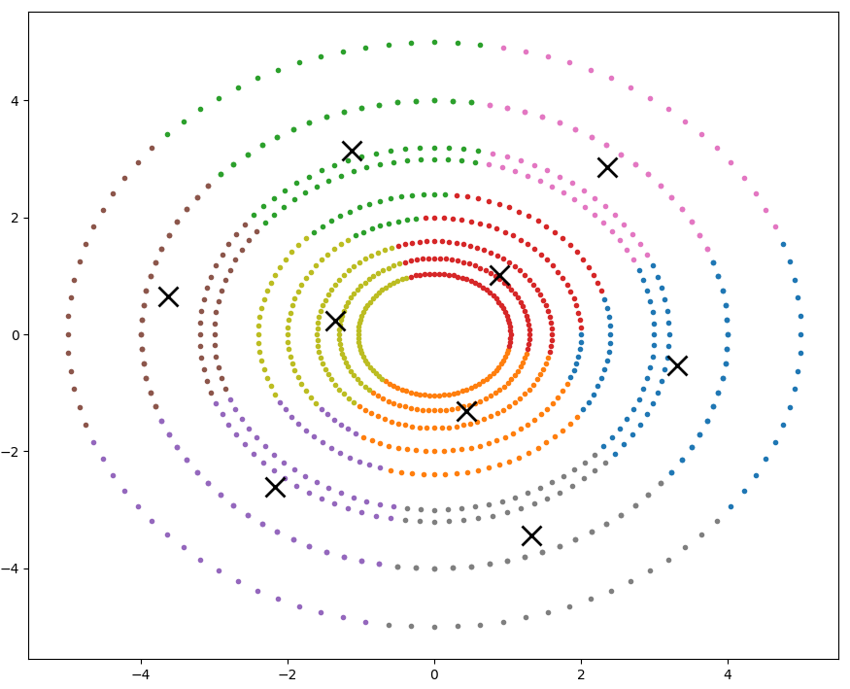
2 Background - Kernel k-means
Suppose radial shaped data
Linear separation not possible, k-means gives

Slide 8
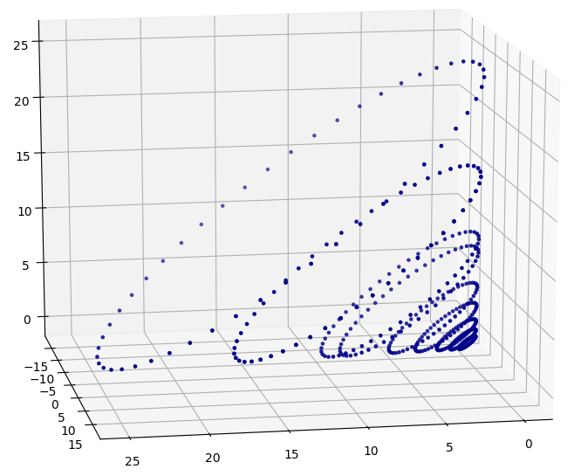
2 Background - Kernel k-means
Use a kernel and apply k-means on projection

Slide 9
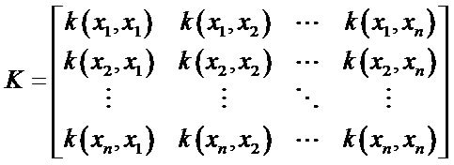
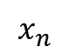
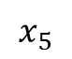
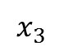
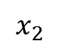
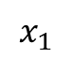
2 Background - Kernel k-means
Kernel matrix is NxN where N = number of points
$$x_{1}$$
$$x_{2}$$
$$x_{3}$$
$$x_{5}$$
$$x_{n}$$
time
N
N

Slide 10

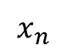
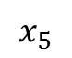
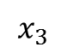
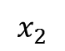
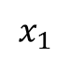
2 Motivation
Clustering non-linearly separable streaming data
Use of kernel k-means
NxN kernel matrix
Stream
Unbounded -> N unbounded
Idea
Sample streaming data based on importance
Apply kernel k-means on sampled data only
$$x_{1}$$
$$x_{2}$$
$$x_{3}$$
$$x_{5}$$
$$x_{n}$$
K=
N
time
N

Slide 11


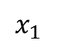
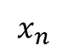
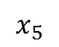
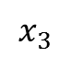
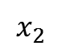
2 Motivation
Sampling: How to get a good representation?
Typically Bernoulli sampling is used
Better: Use statistical leverage scores
$$x_{1}$$
$$x_{2}$$
$$x_{3}$$
$$x_{5}$$
$$x_{n}$$
time
Sample?
P(0.5)
P(0.5)
P(0.5)
P(0.5)
P(0.5)

Slide 12
2 Background – Statistical Leverage
Statistical leverage scores
In statistics: Used for outlier detection

Slide 13
2 Background – Statistical Leverage
Statistical leverage scores
In a matrix: Influential rows and columns, term evolved
How important is a row or column?
A
R

Slide 14
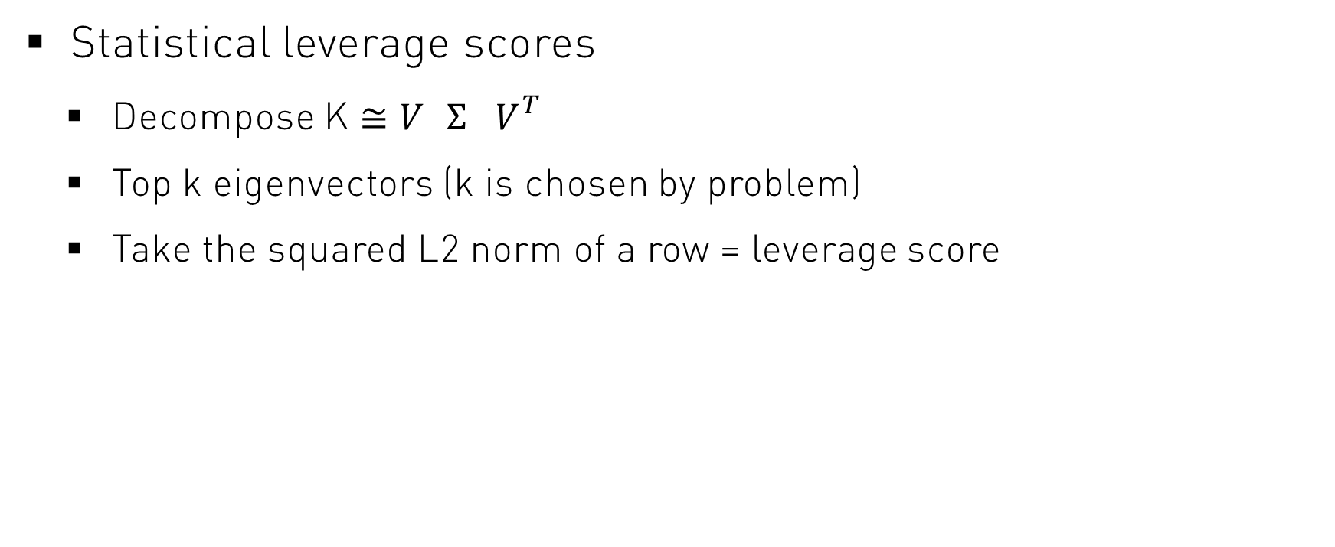
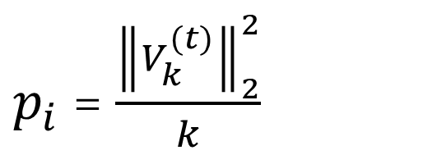
2 Background – Statistical Leverage
Statistical leverage scores
Decompose K $≅V_{}Σ_{}V_{}^{T}$
Top k eigenvectors (k is chosen by problem)
Take the squared L2 norm of a row = leverage score
$p_{i}$ = $\frac{{\left\|V_{k}^{(t)}\right\|}_{2}^{2}}{k}$
choose top k
V

Slide 15

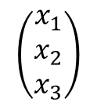
2 Background – Statistical Leverage
Statistical leverage scores
For sampling: Sample an observation or not?
$$\left(\begin{matrix}x_{1} \\ x_{2} \\ x_{3}\end{matrix}\right)$$

Slide 16
2 Motivation
How to control concept shift?
Delete stale clusters
Create new clusters

Slide 17
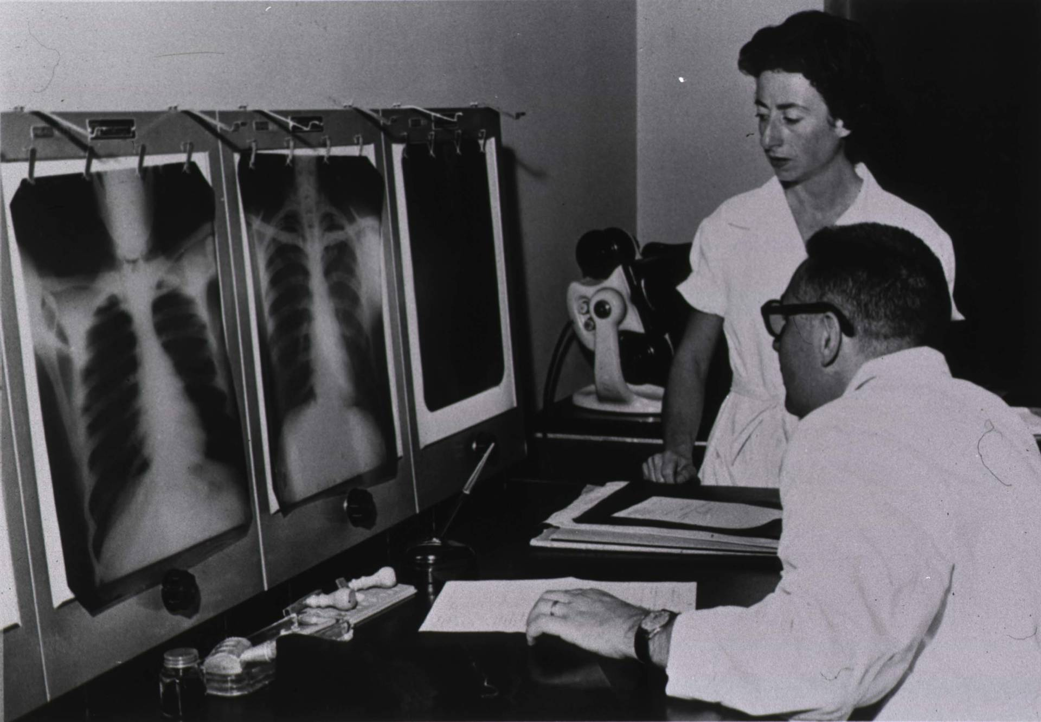
3 Key concepts

Slide 18
3 Key concepts
Sample data based on importance
Cluster the sampled data
Delete stale clusters

Slide 19
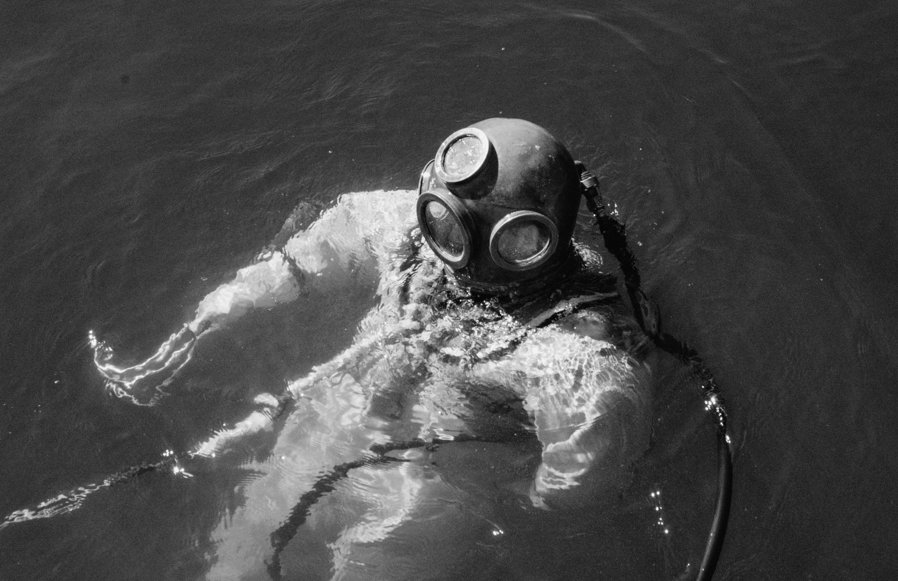
4 Deep Dive with Example

Slide 20
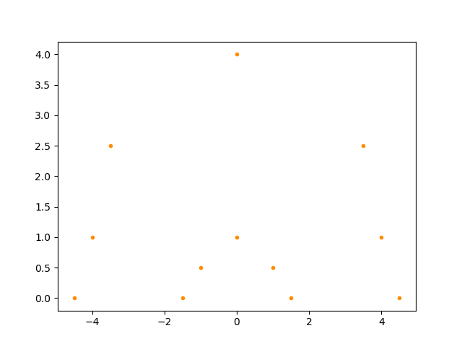
4 Sampling
Suppose this dataset
Not linearly separable
Two clusters

Slide 21
4 Sampling - Overview
Sample an observation or not?
$$\left(\begin{matrix}x_{1} \\ x_{2} \\ x_{3}\end{matrix}\right)$$

Slide 22
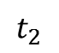
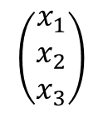
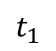
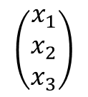
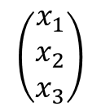
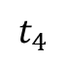
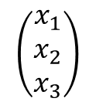
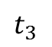
4 Sampling
Based on statistical leverage scores
Observation fits to cluster model?
Use probability
$$\left(\begin{matrix}x_{1} \\ x_{2} \\ x_{3}\end{matrix}\right)$$
$$\left(\begin{matrix}x_{1} \\ x_{2} \\ x_{3}\end{matrix}\right)$$
$$\left(\begin{matrix}x_{1} \\ x_{2} \\ x_{3}\end{matrix}\right)$$
$$\left(\begin{matrix}x_{1} \\ x_{2} \\ x_{3}\end{matrix}\right)$$
Fits?
$$t_{1}$$
$$t_{2}$$
$$t_{3}$$
$$t_{4}$$
time
Probability
0.8
0.6
0.1
0.05

Slide 23
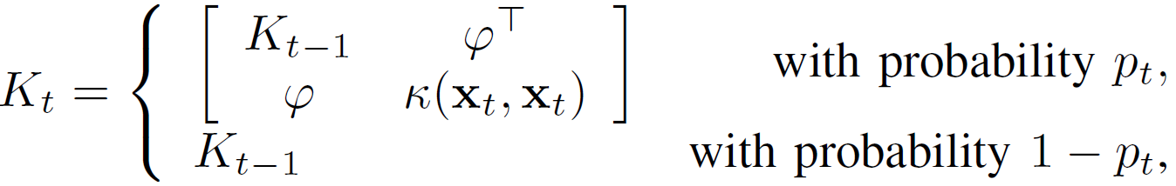
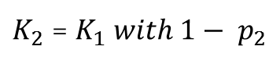
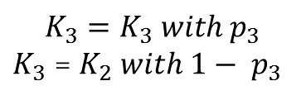
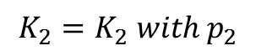
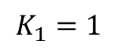
4 Sampling
Calculate probability
With kernel matrix
time
$$K_{1}=1$$
$$K_{2}=K_{2} with{ p}_{2}$$
$$K_{3}=K_{3} with{ p}_{3}$$
$K_{3}$ = $K_{2} with 1− { p}_{3}$
$K_{2}$ = $K_{1} with 1− { p}_{2}$

Slide 24
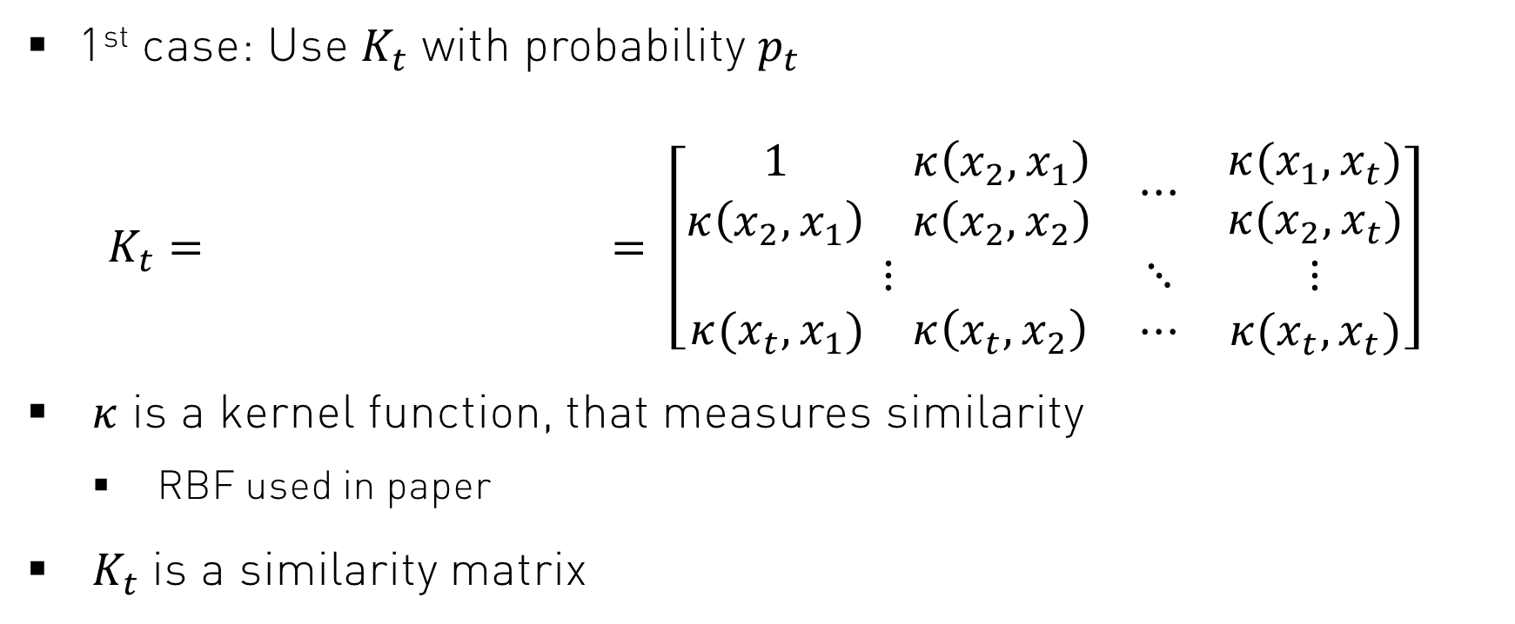
4 Sampling
1st case: Use $K_{t}$ with probability $p_{t}$
$$K_{t}= = \left[\begin{matrix}\begin{matrix}1 & κ\left(x_{2},x_{1}\right) \\ κ\left(x_{2},x_{1}\right) & κ\left(x_{2},x_{2}\right)\end{matrix} & ⋯ & \begin{matrix}κ(x_{1},x_{t}) \\ κ(x_{2},x_{t})\end{matrix} \\ ⋮ & ⋱ & ⋮ \\ \begin{matrix}κ(x_{t},x_{1}) & κ\left(x_{t},x_{2}\right)\end{matrix} & ⋯ & κ(x_{t},x_{t})\end{matrix}\right]$$
$κ$ is a kernel function, that measures similarity
RBF used in paper
$K_{t}$ is a similarity matrix

Slide 25
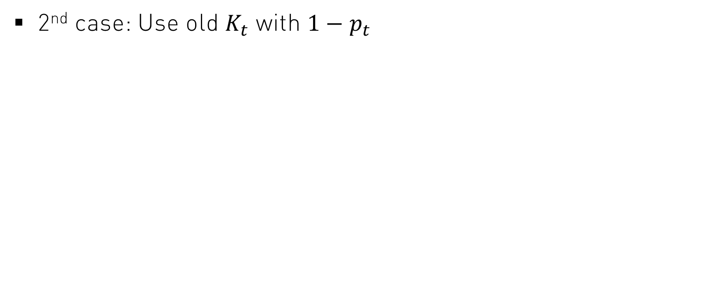
4 Sampling
2nd case: Use old $K_{t}$ with ${1−p}_{t}$

Slide 26
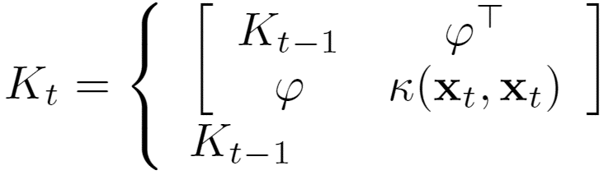
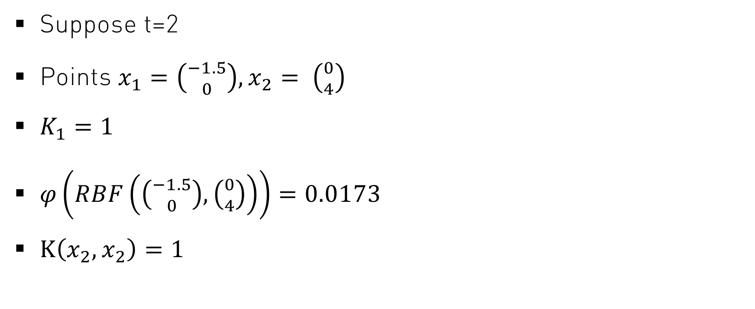
4 Sampling – Example
Suppose t=2
Points $x_{1}=\left({−1.5 \atop 0}\right),x_{2}= \left({0 \atop 4}\right)$
$K_{1}=1$
$φ\left(RBF\left(\left({−1.5 \atop 0}\right),\left({0 \atop 4}\right)\right)\right)=0.0173$
$Κ\left(x_{2}, x_{2}\right)=1$

Slide 27
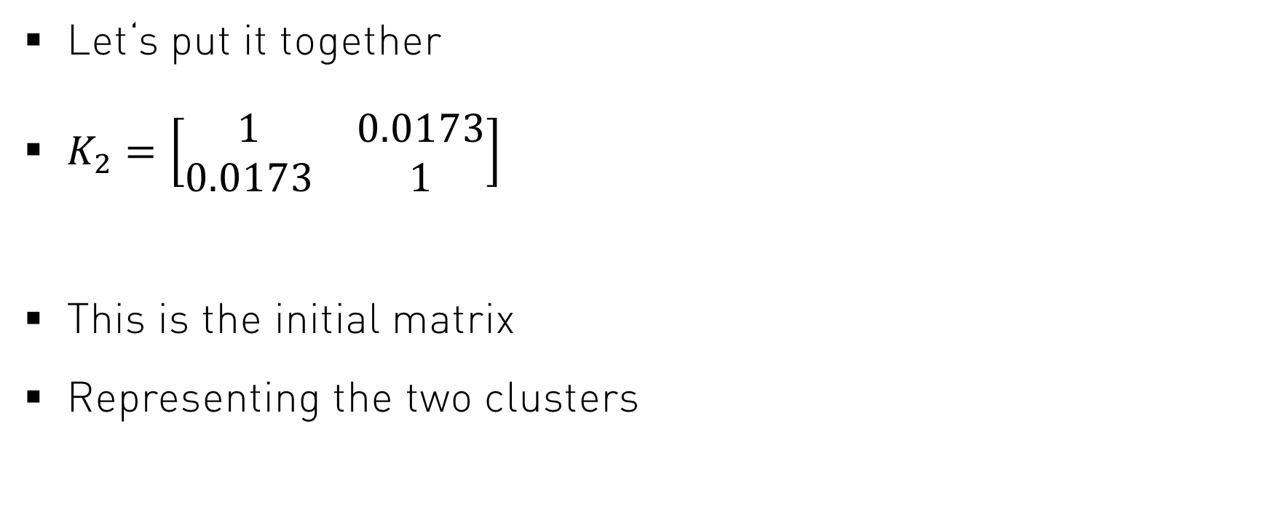
4 Sampling – Example
Let‘s put it together
$K_{2}=\left[\begin{matrix}1 & 0.0173 \\ 0.0173 & 1\end{matrix}\right]$
This is the initial matrix
Representing the two clusters
x2
x1

Slide 28
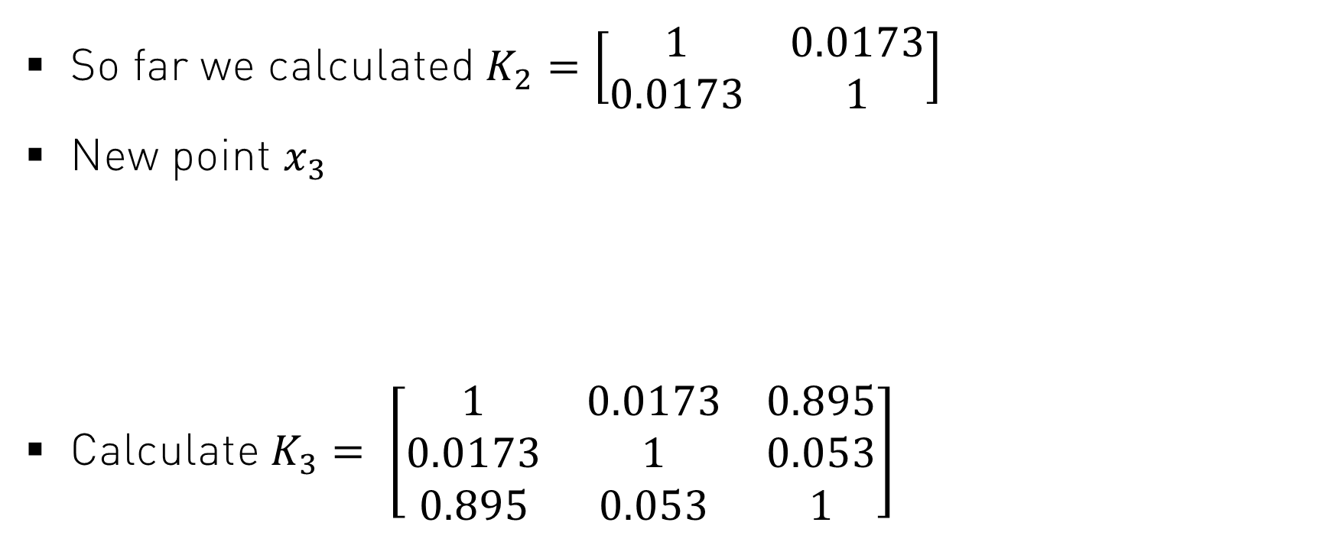



4 Sampling – Example Probability
So far we calculated $K_{2}=\left[\begin{matrix}1 & 0.0173 \\ 0.0173 & 1\end{matrix}\right]$
New point $x_{3}$
Calculate $K_{3}= \left[\begin{matrix}1 & 0.0173 & 0.895 \\ 0.0173 & 1 & 0.053 \\ 0.895 & 0.053 & 1\end{matrix}\right]$
$$\left({−1 \atop 0.5}\right)$$
$$x_{3}$$
$$x_{1}$$
$$x_{2}$$
time

Slide 29






4 Sampling – Probability
$K_{}$at time t
What about the probability?
U$K_{3}$ with $p_{3}$
time
$$K_{1}=\left[1\right]$$
$$K_{2}=\left[\begin{matrix}1 & 0.0173 \\ 0.0173 & 1\end{matrix}\right]$$
$K_{3}$ = $\left[\begin{matrix}1 & 0.0173 & 0.895 \\ 0.0173 & 1 & 0.053 \\ 0.895 & 0.053 & 1\end{matrix}\right]$
$$K_{3}=K_{2}$$
$${\begin{aligned}with p_{3} \\ \\ \\ with {1−p}_{3} \\ \end{aligned}}_{}$$

Slide 30

4 Sampling – Example - Probability
Decompose $K_{t}≅V_{c}Σ_{C}V_{c}^{T}$ where c: number of clusters (2)
$V_{c}$ are the top c eigenvectors
$Σ_{C}$ are the top c eigenvalues
Apply the probability formula
$p_{t}= \frac{1}{C} {\left\|V_{c}^{(t)}\right\|}_{2}^{2}$
${\left\|V_{c}^{(t)}\right\|}_{2}^{2}$ is the squared L2 norm i.e. ${\sqrt{{V_{C_{(1)}}^{(t)}}^{2}+{V_{C_{(2)}}^{(t)}}^{2}+…}}^{2}$
V

Slide 31

4 Sampling – Example - Probability
Calculate $p_{t}$
Decomposition $K_{t}≅V_{c}Σ_{C}V_{c}^{T}$
Two clusters → C = 2
$V_{2}=\left[\begin{matrix}0.705 \\ 0.055 \\ 0.706 \end{matrix}\begin{matrix}0.706 \\ 0.028 \\ −0.707\end{matrix} \right], V_{2}^{(3)}=(0.706 −0.707)$
$p_{3}= \frac{1}{C} {\left\|V_{1}^{(3)}\right\|}_{2}^{2}$= $\frac{1}{2}$ ${\sqrt{{0.706}^{2}+{(−0.707)}^{2}}}^{2}=0.499$
Use $K_{3}$ with a probability of 0.499
x2
x3
x1

Slide 32

4 Sampling – Example Probability
What happens if x3 is an outlier (6,6)?
$p_{3}=0.0017$
x3
x2
x1

Slide 33



4 Clustering
$$x_{t}$$
sampled
not sampled
Update kernel matrix Recluster by executing k-means
Find closest cluster Assign $x_{t}$to cluster if cluster is recent Create new cluster if not
x2
x3
x1

Slide 34


4 Cluster deletion
Find stale clusters
Time threshold is exceeded
$$\left(\begin{matrix}\#points \\ center \\ lastUpdate\end{matrix}\right)$$
Cluster

Slide 35

5 Discussion

Slide 36


5 Conclusion
Bernoulli, p=0.5, 1000 points, 50 samples
Importance sampling, 1000 points, 30 samples

Slide 37
5 Conclusion
Combination of well known techniques
Better cluster quality as StreamKM++ and sKKM, but longer running time
Initial number of clusters must be known
Loss of long-term history
Representation of clusters depends on order of arrival

Slide 38

5 Appendix Performance
Recalculating eigensystem every time is expensive $O\left(s^{3}\right)$
Use fast rank-one update mechanism
Update $K_{t}$ only with new row and column
Usage of approximate kernel k-means
$O\left(NCM\right)$
N = number of points in stream (upper bound), C = cluster size (constant), M = maximum number of points (constant)

Slide 39

Appendix – Approximate Clustering
$\min_{U ∈ {\left\{0,1\right\}}^{k × s}}{\max_{c_{j}\left(∙\right)∈H_{a}}{\sum_{j=1}^{k}{\sum_{i=1}^{s}{\frac{U_{ji}}{s}}}}}{\left\|c_{j}\left(∙\right) − κ(x_{i},∙)\right\|}_{H_{k}}^{2}$
$c_{j}\left(∙\right)= \frac{1}{n_{k}}{{V_{c}Σ}_{c}}^{1/2}$ where $n_{k}$ is the number of points in a cluster
Reduce to space $H_{a}=span (v_{1}, …v_{c})$

Slide 40

Appendix – Kernel K-means

